Slide 1

DATA 515A
Software Design for Data Scientists Data Visualization in Dash
Joseph Hellerstein^{1,3}, Bernease Herman^{1,} Sam Gao³
¹eScience Institute
³Computer Science
University of Washington
April, 2019

Slide 2
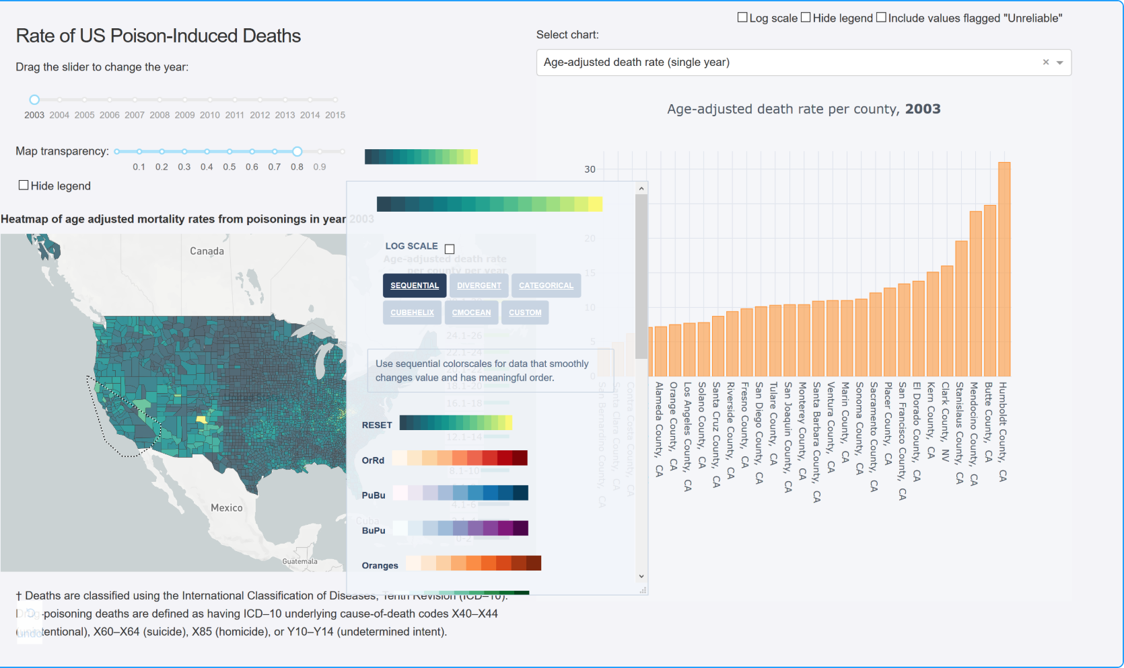
Cool Visualization Using Python Dash

Slide 3
Agenda
HTML and CSS basics
Dash architecture and example
Adding visual elements
Interactions
Testing

Slide 4
Elements of Browser Programming
HTML (hypertext markup language)
Tag language like markdown that controls visual display
CSS (cascading style sheets)
Controls fonts, colors, table styles
JavaScript
Program reaction to browser events

Slide 5
A Brief Tour of HTML
Demo

Slide 6
Dash Visualizations
conda install -c conda-forge dash
import dash
...
app = dash.Dash(__name__)
app.layout=[…]
@app.callback(…)
...
if __name__ == '__main__’:
app.run_server()
Python Application
Web Browser
End User

Slide 7
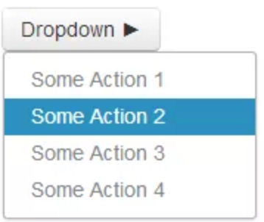
DASH Layout Nested Grid

Slide 8
Callbacks Connects dash names with python names
@app.callback(
Output(component_id='my-div’, component_property='children'),
[Input(component_id='my-id', component_property='value')]
)
def update_output_div(input_value):
return 'You\'ve entered "{}"'.format(input_value)

Slide 9
Essence of Dash Visualization API
A visualization is a grid of components.
A grid (html.Div) specifies the position of components in terms of rows and columns.
A component is an object whose visual characteristics are controlled by its properties. A grid is a component.
Python codes respond to user interactions with components via callbacks that specify:
Inputs from one or more component properties that can be modified through user interactions.
Output that updates at most one component property

Slide 10
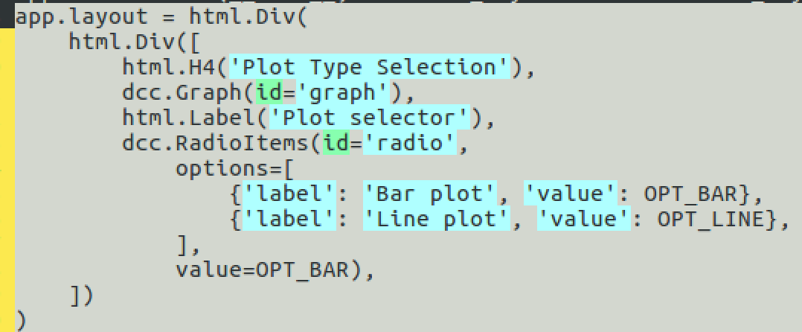

Dash Callbacks
id
property

Slide 11
References
w3Schools HTML Tutorial
w3Schools CSS Tutorial
w3Schools JavaScript Tutorial
Dash Users Guide

Slide 12
Survey
https://tinyurl.com/2019WebApps

